Slide 1
Virtual Machines and Virtualization of Clusters and Data Centers

Slide 2
Overview
• The reincarnation of virtual machines (VMs) presents a great opportunity for parallel, cluster, grid, cloud, and distributed computing.
• Virtualization technology benefits the computer and IT industries by enabling users to share expensive hardware resources by multiplexing VMs on the same set of hardware hosts.
• This chapter covers virtualization levels, VM architectures, virtual networking, virtual cluster construction, and virtualized data-center design and automation in cloud computing.
• In particular, the designs of dynamically structured clusters, grids, and clouds are presented with VMs and virtual clusters.

Slide 3
3.1 IMPLEMENTATION LEVELS OF VIRTUALIZATION
• Virtualization is a computer architecture technology by which multiple virtual machines (VMs) are multiplexed in the same hardware machine.
• The idea of VMs can be dated back to the 1960s [53]. The purpose of a VM is to enhance resource sharing by many users and improve computer performance in terms of resource utilization and application flexibility.
• Hardware resources (CPU, memory, I/O devices, etc.) or software resources (operating system and software libraries) can be virtualized in various functional layers.
• This virtualization technology has been revitalized as the demand for distributed and cloud computing increased sharply in recent years [41].

Slide 4
3.1.1 Levels of Virtualization Implementation
• A traditional computer runs with a host operating system specially tailored for its hardware architecture, as shown in Figure 3.1(a).
• After virtualization, different user applications managed by their own operating systems (guest OS) can run on the same hardware, independent of the host OS.
• This is often done by adding additional software, called a virtualization layer as shown in Figure 3.1(b).
• This virtualization layer is known as hypervisor or virtual machine monitor (VMM) [54]. The VMs are shown in the upper boxes, where applications run with their own guest OS over the virtualized CPU, memory, and I/O resources.
• The main function of the software layer for virtualization is to virtualize the physical hardware of a host machine into virtual resources to be used by the VMs, exclusively.
• This can be implemented at various operational levels, as we will discuss shortly.

Slide 5
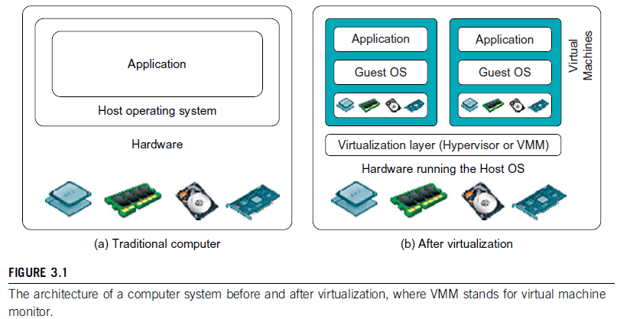
3.1.1 Levels of Virtualization Implementation

Slide 6
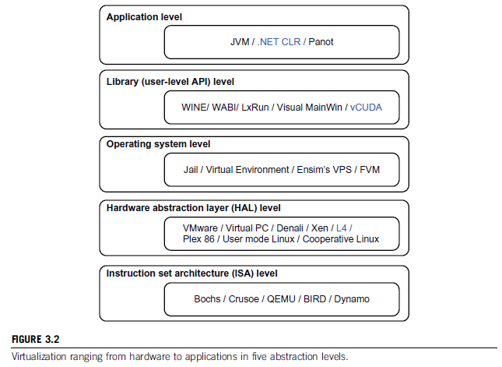
3.1.1 Levels of Virtualization Implementation
•The virtualization software creates the abstraction of VMs by interposing a virtualization layer at various levels of a computer system.
•Common virtualization layers include the instruction set architecture (ISA) level, hardware level, operating system level, library support level, and application level.

Slide 7
3.1.1.1 Instruction Set Architecture Level
• At the ISA level, virtualization is performed by emulating a given ISA by the ISA of the host machine.
• For example, MIPS binary code can run on an x86-based host machine with the help of ISA emulation. With this approach, it is possible to run a large amount of legacy binary code written for various processors on any given new hardware host machine. Instruction set emulation leads to virtual ISAs created on any hardware machine.
• The basic emulation method is through code interpretation. An interpreter program interprets the source instructions to target instructions one by one. One source instruction may require tens or hundreds of native target instructions to perform its function. Obviously, this process is relatively slow.
• For better performance, dynamic binary translation is desired. This approach translates basic blocks of dynamic source instructions to target instructions.
• A virtual instruction set architecture (V-ISA) thus requires adding a processor-specific software translation layer to the compiler.

Slide 8
3.1.1.2 Hardware Abstraction Level
• Hardware-level virtualization is performed right on top of the bare hardware.
• On the one hand, this approach generates a virtual hardware environment for a VM. The process manages the underlying hardware through virtualization.
• The idea is to virtualize a computer’s resources, such as its processors, memory, and I/O devices.
• The intention is to upgrade the hardware utilization rate by multiple users concurrently.
• The idea was implemented in the IBM VM/370 in the 1960s. More recently, the Xen hypervisor has been applied to virtualize x86-based machines to run Linux or other guest OS applications.
• We will discuss hardware virtualization approaches in more detail in Section 3.3

Slide 9
3.1.1.3 Operating System Level
•This refers to an abstraction layer between traditional OS and user applications. OS-level virtualization creates isolated containers on a single physical server and the OS instances to utilize the hardware and software in data centers. The containers behave like real servers.
•OS-level virtualization is commonly used in creating virtual hosting environments to allocate hardware resources among a large number of mutually distrusting users.
•It is also used, to a lesser extent, in consolidating server hardware by moving services on separate hosts into containers or VMs on one server.
•OS-level virtualization is depicted in Section 3.1.3.

Slide 10
3.1.1.4 Library Support Level
• Most applications use APIs exported by user-level libraries rather than using lengthy system calls by the OS.
• Since most systems provide well-documented APIs, such an interface becomes another candidate for virtualization. Virtualization with library interfaces is possible by controlling the communication link between applications and the rest of a system through API hooks.
• The software tool WINE has implemented this approach to support Windows applications on top of UNIX hosts.
• Another example is the vCUDA which allows applications executing within VMs to leverage GPU hardware acceleration.
• This approach is detailed in Section 3.1.4.

Slide 11
3.1.1.5 User-Application Level
• Virtualization at the application level virtualizes an application as a VM. On a traditional OS, an application often runs as a process.
• Therefore, application-level virtualization is also known as process-level virtualization.
• The most popular approach is to deploy high level language (HLL) VMs. In this scenario, the virtualization layer sits as an application program on top of the operating system, and the layer exports an abstraction of a VM that can run programs written and compiled to a particular abstract machine definition.
• Any program written in the HLL and compiled for this VM will be able to run on it.
• The Microsoft .NET CLR and Java Virtual Machine (JVM) are two good examples of this class of VM.
• Other forms of application-level virtualization are known as application isolation, application sandboxing, or application streaming. The process involves wrapping the application in a layer that is isolated from the host OS and other applications. The result is an application that is much easier to distribute and remove from user workstations.

Slide 12
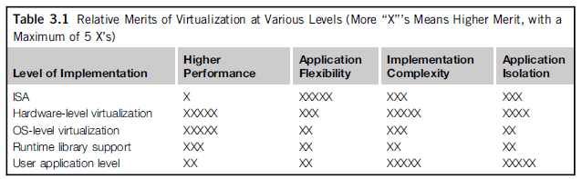
3.1.1.6 Relative Merits of Different Approaches
• Table 3.1 compares the relative merits of implementing virtualization at various levels. The column headings correspond to four technical merits.
• “Higher Performance” and “Application Flexibility” are self-explanatory.
• “Implementation Complexity” implies the cost to implement that particular virtualization level.
• “Application Isolation” refers to the effort required to isolate resources committed to different VMs.
• Each row corresponds to a particular level of virtualization.
• The number of X’s in the table cells reflects the advantage points of each implementation level. Five X’s implies the best case and one X implies the worst case.
• Overall, hardware and OS support will yield the highest performance. However, the hardware and application levels are also the most expensive to implement.
• User isolation is the most difficult to achieve. ISA implementation offers the best application flexibility.

Slide 13
3.1.2 VMM Design Requirements and Providers
• As mentioned earlier, hardware-level virtualization inserts a layer between real hardware and traditional operating systems. This layer is commonly called the Virtual Machine Monitor (VMM) and it manages the hardware resources of a computing system.
• Each time programs access the hardware, the VMM captures the process. In this sense, the VMM acts as a traditional OS. One hardware component, such as the CPU, can be virtualized as several virtual copies. Therefore, several traditional operating systems which are the same or different can sit on the same set of hardware simultaneously.
• There are three requirements for a VMM.
• First, a VMM should provide an environment for programs which is essentially identical to the original machine.
• Second, programs run in this environment should show, at worst, only minor decreases in speed.
• Third, a VMM should be in complete control of the system resources. Any program run under a VMM should exhibit a function identical to that which it runs on the original machine directly.
• Two possible exceptions in terms of differences are permitted with this requirement:
1) differences caused by the availability of system resources . This one arises when more than one VM is running on the same machine. The hardware resource requirements, such as memory, of each VM are reduced, but the sum of them is greater than that of the real machine installed.
2) differences caused by timing dependencies. This qualification is required because of the intervening level of software and the effect of any other VMs concurrently existing on the same hardware.

Slide 14
3.1.2 VMM Design Requirements and Providers
• Obviously, these two differences pertain to performance, while the function a VMM provides stays the same as that of a real machine.
• A VMM should demonstrate efficiency in using the VMs. Compared with a physical machine, no one prefers a VMM if its efficiency is too low.
• Traditional emulators and complete software interpreters (simulators) emulate each instruction by means of functions or macros. Such a method provides the most flexible solutions for VMMs. However, emulators or simulators are too slow to be used as real machines.
• To guarantee the efficiency of a VMM, a statistically dominant subset of the virtual processor’s instructions needs to be executed directly by the real processor, with no software intervention by the VMM.

Slide 15
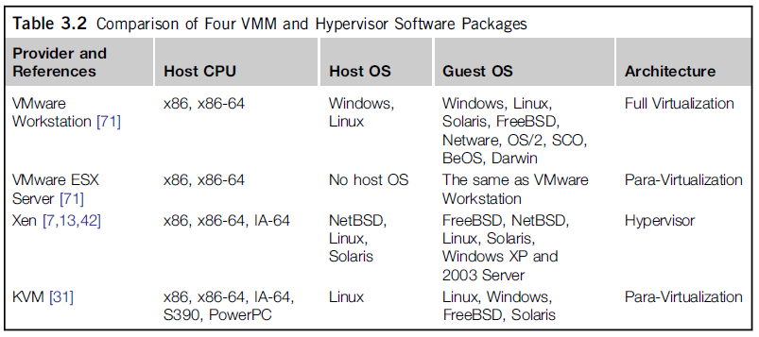
3.1.2 VMM Design Requirements and Providers
•Table 3.2 compares four hypervisors and VMMs that are in use today.

Slide 16
3.1.2 VMM Design Requirements and Providers
• Complete control of these resources by a VMM includes the following aspects:
(1) The VMM is responsible for allocating hardware resources for programs;
(2) It is not possible for a program to access any resource not explicitly allocated to it;
(3) It is possible under certain circumstances for a VMM to regain control of resources already allocated.
• Not all processors satisfy these requirements for a VMM. A VMM is tightly related to the architectures of processors. It is difficult to implement a VMM for some types of processors, such as the x86. Specific limitations include the inability to trap on some privileged instructions.
• If a processor is not designed to support virtualization primarily, it is necessary to modify the hardware to satisfy the three requirements for a VMM. This is known as hardware-assisted virtualization.

Slide 17
3.1.3 Virtualization Support at the OS Level
• With the help of VM technology, a new computing mode known as cloud computing is emerging.
• Cloud computing is transforming the computing landscape by shifting the hardware and staffing costs of managing a computational center to third parties, just like banks.
• However, cloud computing has at least two challenges.
• The first challenge is the ability to use a variable number of physical machines and VM instances depending on the needs of a problem. For example, a task may need only a single CPU during some phases of execution but may need hundreds of CPUs at other times.
• The second challenge concerns the slow operation of instantiating new VMs. Currently, new VMs originate either as fresh boots or as replicates of a template VM, unaware of the current application state. Therefore, to better support cloud computing, a large amount of research and development should be done.

Slide 18
3.1.3 Virtualization Support at the OS Level
•As mentioned earlier, it is slow to initialize a hardware-level VM because each VM creates its own image from scratch.
•In a cloud computing environment, perhaps thousands of VMs need to be initialized simultaneously.
•Besides slow operation, storing the VM images also becomes an issue. As a matter of fact, there is considerable repeated content among VM images.
•Moreover, full virtualization at the hardware level also has the disadvantages of slow performance and low density, and the need for para-virtualization to modify the guest OS.
•To reduce the performance overhead of hardware-level virtualization, even hardware modification is needed.

Slide 19
3.1.3.1 Why OS-Level Virtualization?
VE
OS-level virtualization provides a feasible solution for these hardware-level virtualization issues.
• Operating system virtualization inserts a virtualization layer inside an operating system to partition a machine’s physical resources.
• It enables multiple isolated VMs within a single operating system kernel. This kind of VM is often called a virtual execution environment (VE), Virtual Private System (VPS), or simply container.
• From the user’s point of view, VEs look like real servers.
• This means a VE has its own set of processes, file system, user accounts, network interfaces with IP addresses, routing tables, firewall rules, and other personal settings.
• Although VEs can be customized for different people, they share the same operating system kernel. Therefore, OS-level virtualization is also called single-OS image virtualization.
• Figure 3.3 illustrates operating system virtualization from the point of view of a machine stack.

Slide 20
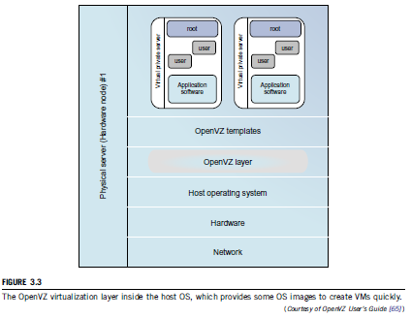
3.1.3.1 Why OS-Level Virtualization?

Slide 21
3.1.3.2 Advantages of OS Extensions
• Compared to hardware-level virtualization, the benefits of OS extensions are twofold:
(1) VMs at the operating system level have minimal startup /shutdown costs, low resource requirements, and high scalability;
(2) for an OS-level VM, it is possible for a VM and its host environment to synchronize state changes when necessary.
•These benefits can be achieved via two mechanisms of OS-level virtualization:
(1) All OS-level VMs on the same physical machine share a single operating system kernel;
(2) the virtualization layer can be designed in a way that allows processes in VMs to access as many resources of the host machine as possible.
• In cloud computing, the first and second benefits can be used to overcome the defects of slow initialization of VMs at the hardware level, and being unaware of the current application state, respectively.

Slide 22
3.1.3.3 Disadvantages of OS Extensions
• The main disadvantage of OS extensions is that all the VMs at operating system level on a single container must have the same kind of guest operating system. That is, although different OS-level VMs may have different operating system distributions, they must pertain to the same operating system family.
• For example, a Windows distribution such as Windows XP cannot run on a Linux-based container. However, users of cloud computing have various preferences. Some prefer Windows and others prefer Linux or other operating systems. Therefore, there is a challenge for OS-level virtualization in such cases.
• Figure 3.3 illustrates the concept of OS-level virtualization. The virtualization layer is inserted inside the OS to partition the hardware resources for multiple VMs to run their applications in multiple virtual environments. To implement OS-level virtualization, isolated execution environments (VMs) should be created based on a single OS kernel.

Slide 23
3.1.3.4 Virtualization on Linux or Windows Platforms
•By far, most reported OS-level virtualization systems are Linux-based. Virtualization support on the Windows-based platform is still in the research stage. The Linux kernel offers an abstraction layer to allow software processes to work with and operate on resources without knowing the hardware details.
•Table 3.3 summarizes several examples of OSlevel virtualization tools that have been developed in recent years. Two OS tools (Linux vServer and OpenVZ) support Linux platforms to run other platform-based applications through virtualization. These two OS-level tools are illustrated in Example 3.1.
•The third tool, FVM, is an attempt specifically developed for virtualization on the Windows NT platform.

Slide 24
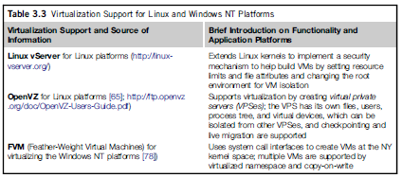
Example 3.1 Virtualization Support for the Linux Platform

Slide 25
3.2 VIRTUALIZATION STRUCTURES/TOOLS AND MECHANISMS
• In general, there are three typical classes of VM architecture. Figure 3.1 showed the architectures of a machine before and after virtualization.
• Before virtualization, the operating system manages the hardware. After virtualization, a virtualization layer is inserted between the hardware and the operating system.
• In such a case, the virtualization layer is responsible for converting portions of the real hardware into virtual hardware. Therefore, different operating systems such as Linux and Windows can run on the same physical machine, simultaneously.
• Depending on the position of the virtualization layer, there are several classes of VM architectures, namely the hypervisor architecture, para-virtualization, and host-based virtualization.
• The hypervisor is also known as the VMM (Virtual Machine Monitor). They both perform the same virtualization operations.

Slide 26
3.2.1 Hypervisor and Xen Architecture
• The hypervisor supports hardware-level virtualization (see Figure 3.1(b)) on devices like CPU, memory, disk and network interfaces.
• The hypervisor software sits directly between the physical hardware and its OS.
• The hypervisor provides hyper-calls for the guest OSes and applications.
• Depending on the functionality, a hypervisor can assume a micro-kernel architecture like the Microsoft Hyper-V. Or it can assume a monolithic hypervisor architecture like the VMware ESX for server virtualization.
• A micro-kernel hypervisor includes only the basic and unchanging functions (such as physical memory management and processor scheduling). The device drivers and other changeable components are outside the hypervisor.
• A monolithic hypervisor implements all the aforementioned functions, including those of the device drivers. Therefore, the size of the hypervisor code of a micro-kernel hypervisor is smaller than that of a monolithic hypervisor.

Slide 27
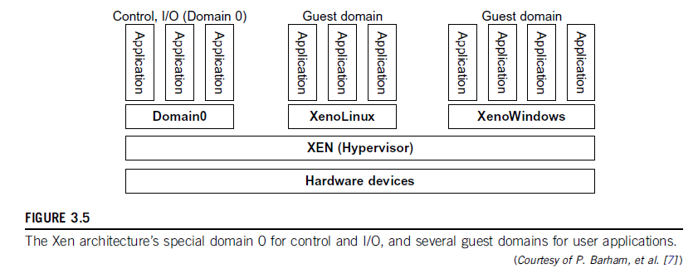
3.2.1.1 The Xen Architecture

Slide 28
3.2.1.1 The Xen Architecture
•Xen is an open source hypervisor program developed by Cambridge University.
•Xen is a microkernel hypervisor, which separates the policy from the mechanism.
•The Xen hypervisor implements all the mechanisms, leaving the policy to be handled by Domain 0, as shown in Figure 3.5.
•Xen does not include any device drivers natively [7]. It just provides a mechanism by which a guest OS can have direct access to the physical devices. As a result, the size of the Xen hypervisor is kept rather small.
•Xen provides a virtual environment located between the hardware and the OS.
•A number of vendors are in the process of developing commercial Xen hypervisors, among them are Citrix XenServer [62] and Oracle VM [42].
•The core components of a Xen system are the hypervisor, kernel, and applications. The organization of the three components is important.

Slide 29
3.2.2 Binary Translation with Full Virtualization
•Depending on implementation technologies, hardware virtualization can be classified into two categories: Full virtualization and host-based virtualization.
•Hypervisor and VMM approaches are considered full virtualization
•Full virtualization does not need to modify the host OS. It relies on binary translation to trap and to virtualize the execution of certain sensitive, non-virtualizable instructions. The guest OSes and their applications consist of non-critical and critical instructions.
•In a host-based system, both a host OS and a guest OS are used. A virtualization software layer is built between the host OS and guest OS.

Slide 30
3.2.2.1 Full Virtualization
•With full virtualization, noncritical instructions run on the hardware directly while critical instructions are discovered and replaced with traps into the VMM to be emulated by software.
•Why are only critical instructions trapped into the VMM? This is because binary translation can incur a large performance overhead. Noncritical instructions do not control hardware or threaten the security of the system, but critical instructions do.
•Therefore, running noncritical instructions on hardware not only can promote efficiency, but also can ensure system security.

Slide 31
3.2.2.2 Binary Translation of Guest OS Requests Using a VMM
•The Binary Translation was implemented by VMware and many other software companies.
•As shown in Figure 3.6, VMware puts the VMM at Ring 0 and the guest OS at Ring 1.
•The VMM scans the instruction stream and identifies the privileged, control- and behaviour-sensitive instructions.
•When these instructions are identified, they are trapped into the VMM, which emulates the behaviour of these instructions.
•The method used in this emulation is called binary translation.
•Therefore, full virtualization combines binary translation and direct execution.
•The guest OS is completely decoupled from the underlying hardware. Consequently, the guest OS is unaware that it is being virtualized.
•The performance of full virtualization may not be ideal, because it involves binary translation which is rather time-consuming.
•In particular, the full virtualization of I/O-intensive applications is a really a big challenge. Binary translation employs a code cache to store translated hot instructions to improve performance, but it increases the cost of memory usage.
•At the time of this writing, the performance of full virtualization on the x86 architecture is typically 80 percent to 97 percent that of the host machine.

Slide 32
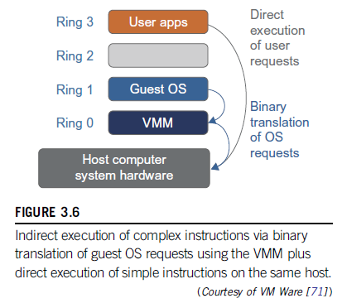
3.2.2.2 Binary Translation of Guest OS Requests Using a VMM

Slide 33
3.2.2.3 Host-Based Virtualization
•An alternative VM architecture is to install a virtualization layer on top of the host OS.
•This host OS is still responsible for managing the hardware.
•The guest OSes are installed and run on top of the virtualization layer. Dedicated applications may run on the VMs. Certainly, some other applications can also run with the host OS directly.
•This host-based architecture has some distinct advantages, as enumerated next.
•First, the user can install this VM architecture without modifying the host OS. The virtualizing software can rely on the host OS to provide device drivers and other low-level services. This will simplify the VM design and ease its deployment.
•Second, the host-based approach appeals to many host machine configurations.
•Compared to the hypervisor/VMM architecture, the performance of the host-based architecture may also be low. When an application requests hardware access, it involves four layers of mapping which downgrades performance significantly. When the ISA of a guest OS is different from the ISA of the underlying hardware, binary translation must be adopted.
•Although the host-based architecture has flexibility, the performance is too low to be useful in practice.

Slide 34
3.2.3 Para-Virtualization with Compiler Support
•Para-virtualization needs to modify the guest operating systems.
•A para-virtualized VM provides special APIs requiring substantial OS modifications in user applications.
•The virtualization layer can be inserted at different positions in a machine software stack. However, para-virtualization attempts to reduce the virtualization overhead, and thus improve performance by modifying only the guest OS kernel.
•Figure 3.7 illustrates the concept of a para-virtualized VM architecture. The guest operating systems are para-virtualized. They are assisted by an intelligent compiler to replace the non-virtualizable OS instructions by hypercalls as illustrated in Figure 3.8.
•The traditional x86 processor offers four instruction execution rings: Rings 0, 1, 2, and 3. The lower the ring number, the higher the privilege of instruction being executed. The OS is responsible for managing the hardware and the privileged instructions to execute at Ring 0, while user-level applications run at Ring 3.
•The best example of para-virtualization is the KVM to be described below.

Slide 35
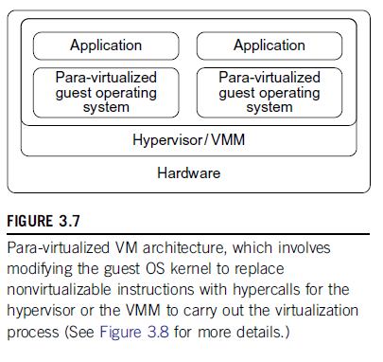
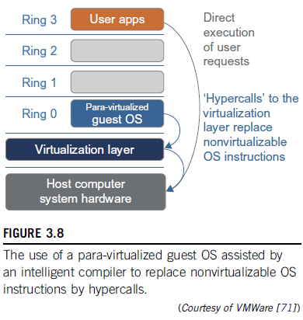
3.2.3 Para-Virtualization with Compiler Support

Slide 36
3.2.3 Para-Virtualization with Compiler Support
•Although para-virtualization reduces the overhead, it has incurred other problems.
•First, its compatibility and portability may be in doubt, because it must support the unmodified OS as well.
•Second, the cost of maintaining para-virtualized OSes is high, because they may require deep OS kernel modifications.
•Finally, the performance advantage of para-virtualization varies greatly due to workload variations.
•Compared with full virtualization, para-virtualization is relatively easy and more practical.
•The main problem in full virtualization is its low performance in binary translation. To speed up binary translation is difficult. Therefore, many virtualization products employ the para-virtualization architecture. The popular Xen, KVM, and VMware ESX are good examples.

Slide 37
3.2.3 Para-Virtualization with Compiler Support
KVM (Kernel-Based VM)
•KVM is a Linux para-virtualization system—a part of the Linux version 2.6.20 kernel.
•Memory management and scheduling activities are carried- out by the existing Linux kernel.
•The KVM does the rest, which makes it simpler than the hypervisor that controls the entire machine.
•KVM is a hardware-assisted para-virtualization tool, which improves performance and supports unmodified guest OSes such as Windows, Linux, Solaris, and other UNIX variants.

Slide 38
3.2.3 Para-Virtualization with Compiler Support
•Unlike the full virtualization architecture which intercepts and emulates privileged and sensitive instructions at runtime, para-virtualization handles these instructions at compile time.
•The guest OS kernel is modified to replace the privileged and sensitive instructions with hypercalls to the hypervisor or VMM.
•Xen assumes such a para-virtualization architecture. The guest OS running in a guest domain may run at Ring 1 instead of at Ring 0.
•This implies that the guest OS may not be able to execute some privileged and sensitive instructions. The privileged instructions are implemented by hypercalls to the hypervisor.
•After replacing the instructions with hypercalls, the modified guest OS emulates the behavior of the original guest OS.

Slide 39
Example 3.3 VMware ESX Server for Para-Virtualization
•VMware company has developed virtualization tools for desktop systems and servers as well as virtual infrastructure for large data centers.
•ESX is a VMM or a hypervisor for bare-metal x86 symmetric multiprocessing (SMP) servers.
•It accesses hardware resources such as I/O directly and has complete resource management control.
•An ESX-enabled server consists of four components: a virtualization layer, a resource manager, hardware interface components, and a service console, as shown in Figure 3.9.
•To improve performance, the ESX server employs a para-virtualization architecture in which the VM kernel interacts directly with the hardware without involving the host OS.
•The VMM layer virtualizes the physical hardware resources such as CPU, memory, network and disk controllers, and human interface devices.
•Every VM has its own set of virtual hardware resources. The resource manager allocates CPU, memory disk, and network bandwidth and maps them to the virtual hardware resource set of each VM created.
•Hardware interface components are the device drivers and the VMware ESX Server File System.
•The service console is responsible for booting the system, initiating the execution of the VMM and resource manager, and relinquishing control to those layers. It also facilitates the process for system administrators.

Slide 40
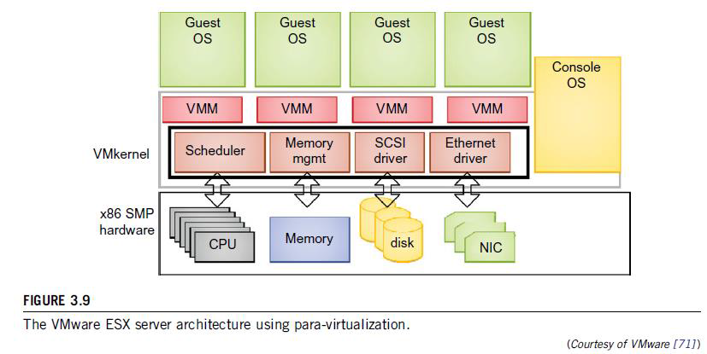
Example 3.3 VMware ESX Server for Para-Virtualization

Slide 41
3.3 VIRTUALIZATION OF CPU, MEMORY, AND I/O DEVICES
•To support virtualization, processors such as the x86 employ a special running mode and instructions, known as hardware-assisted virtualization.
•In this way, the VMM and guest OS run in different modes and all sensitive instructions of the guest OS and its applications are trapped in the VMM.
•To save processor states, mode switching is completed by hardware. For the x86 architecture, Intel and AMD have proprietary technologies for hardware-assisted virtualization.

Slide 42
3.3.1 Hardware Support for Virtualization
•Modern operating systems and processors permit multiple processes to run simultaneously. If there is no protection mechanism in a processor, all instructions from different processes will access the hardware directly and cause a system crash.
•Therefore, all processors have at least two modes, user mode and supervisor mode, to ensure controlled access of critical hardware.
•Instructions running in supervisor mode are called privileged instructions. Other instructions are unprivileged instructions.
•In a virtualized environment, it is more difficult to make OSes and applications run correctly because there are more layers in the machine stack. Example 3.4 discusses Intel’s hardware support approach.
•The Vmware Workstation is a VM software suite for x86 and x86-64 computers. This software suite allows users to set up multiple x86 and x86-64 virtual computers and to use one or more of these VMs simultaneously with the host operating system. The VMware Workstation assumes the host-based virtualization.
•Xen is a hypervisor for use in IA-32, x86-64, Itanium, and PowerPC 970 hosts. Actually, Xen modifies Linux as the lowest and most privileged layer, or a hypervisor. One or more guest OS can run on top of the hypervisor.
•KVM (Kernel-based Virtual Machine) is a Linux kernel virtualization infrastructure. KVM can support hardware-assisted virtualization and para-virtualization by using the Intel VT-x or AMD-v and VirtIO framework, respectively.
•The VirtIO framework includes a para-virtual Ethernet card, a disk I/O controller, a balloon device for adjusting guest memory usage, and a VGA graphics interface using VMware drivers.

Slide 43
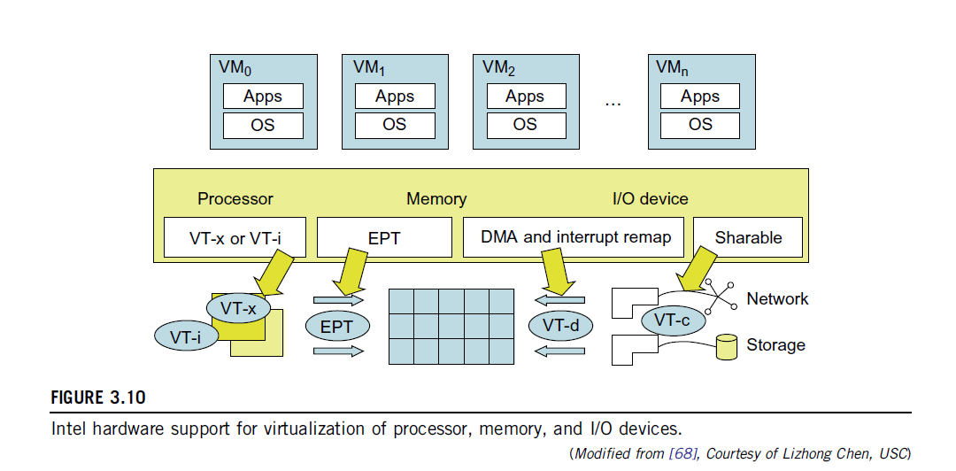
3.3.1 Hardware Support for Virtualization
For processor virtualization, Intel offers the VT-x or VT-i technique. VT-x adds a privileged mode (VMX Root Mode) and some instructions to processors. This nhancement traps all sensitive instructions in the VMM automatically.
For memory virtualization, Intel offers the EPT, which translates the virtual address to the machine’s physical addresses to improve performance.
For I/O virtualization, Intel implements VT-d and VT-c to support this.

Slide 44
3.3.2 CPU Virtualization
•A VM is a duplicate of an existing computer system in which a majority of the VM instructions are executed on the host processor in native mode.
•Thus, unprivileged instructions of VMs run directly on the host machine for higher efficiency. Other critical instructions should be handled carefully for correctness and stability.
•The critical instructions are divided into three categories:
1) privileged instructions, 2) control-sensitive instructions, and 3) behavior-sensitive instructions.
•Privileged instructions execute in a privileged mode and will be trapped if executed outside this mode.
•Control-sensitive instructions attempt to change the configuration of resources used.
•Behavior-sensitive instructions have different behaviors depending on the configuration of resources, including the load and store operations over the virtual memory.

Slide 45
3.3.2 CPU Virtualization
•A CPU architecture is virtualizable if it supports the ability to run the VM’s privileged and unprivileged instructions in the CPU’s user mode while the VMM runs in supervisor mode.
•When the privileged instructions including control- and behavior-sensitive instructions of a VM are executed, they are trapped in the VMM. In this case, the VMM acts as a unified mediator for hardware access from different VMs to guarantee the correctness and stability of the whole system.
•However, not all CPU architectures are virtualizable. RISC CPU architectures can be naturally virtualized because all control- and behavior-sensitive instructions are privileged instructions.
•On the contrary, x86 CPU architectures are not primarily designed to support virtualization. This is because about 10 sensitive instructions, such as SGDT (Store Global Descriptor Table Register) and SMSW (Store Machine Status Word), are not privileged instructions. When these instructions execute in virtualization, they cannot be trapped in the VMM.

Slide 46
3.3.2 CPU Virtualization
•On a native UNIX-like system, a system call triggers the 80h interrupt and passes control to the OS kernel. The interrupt handler in the kernel is then invoked to process the system call.
•On a para-virtualization system such as Xen, a system call in the guest OS first triggers the 80h interrupt normally. Almost at the same time, the 82h interrupt in the hypervisor is triggered. Incidentally, control is passed on to the hypervisor as well.
•When the hypervisor completes its task for the guest OS system call, it passes control back to the guest OS kernel.
•Certainly, the guest OS kernel may also invoke the hypercall while it’s running.
•Although para-virtualization of a CPU lets unmodified applications run in the VM, it causes a small performance penalty.

Slide 47
3.3.2.1 Hardware-Assisted CPU Virtualization
•This technique attempts to simplify virtualization because full or para-virtualization is complicated.
•Intel and AMD add an additional mode called privilege mode level (some people call it Ring-1) to x86 processors.
•Therefore, operating systems can still run at Ring 0 and the hypervisor can run at Ring -1.
•All the privileged and sensitive instructions are trapped in the hypervisor automatically.
•This technique removes the difficulty of implementing binary translation of full virtualization.
•It also lets the operating system run in VMs without modification.

Slide 48
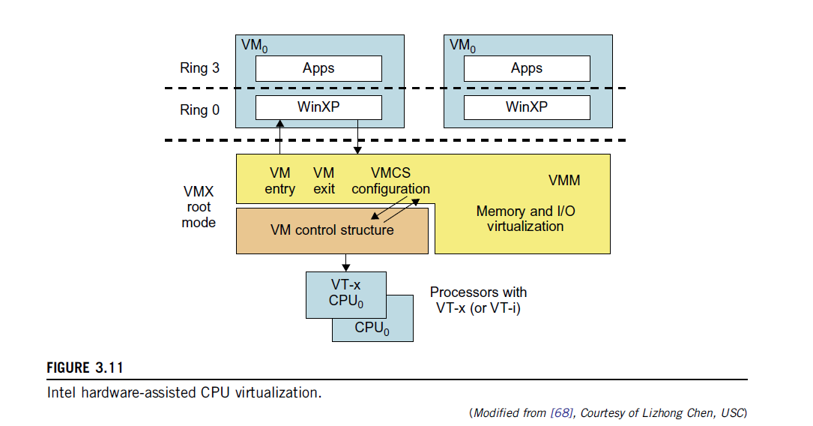
3.3.2.1 Hardware-Assisted CPU Virtualization

Slide 49
3.3.3 Memory Virtualization
•Virtual memory virtualization is similar to the virtual memory support provided by modern operating systems.
•In a traditional execution environment, the operating system maintains mappings of virtual memory to machine memory using page tables, which is a one-stage mapping from virtual memory to machine memory.
•All modern x86 CPUs include a memory management unit (MMU) and a translation lookaside buffer (TLB) to optimize virtual memory performance.
•However, in a virtual execution environment, virtual memory virtualization involves sharing the physical system memory in RAM and dynamically allocating it to the physical memory of the VMs.
•That means a two-stage mapping process should be maintained by the guest OS and the VMM, respectively: 1) virtual memory to physical memory and 2) physical memory to machine memory.
•Furthermore, MMU virtualization should be supported, which is transparent to the guest OS.
•The guest OS continues to control the mapping of virtual addresses to the physical memory addresses of VMs. But the guest OS cannot directly access the actual machine memory.
•The VMM is responsible for mapping the guest physical memory to the actual machine memory. Figure 3.12 shows the two-level memory mapping procedure.

Slide 50
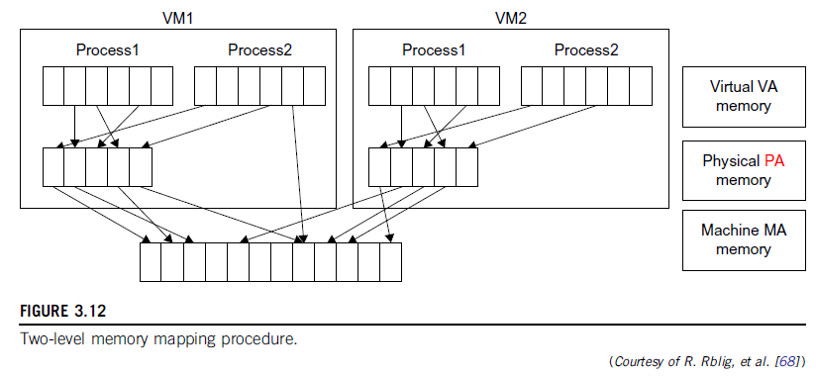
3.3.3 Memory Virtualization

Slide 51
3.3.3 Memory Virtualization
•Since each page table of the guest OSes has a separate page table in the VMM corresponding to it, the VMM page table is called the shadow page table.
•Nested page tables add another layer of indirection to virtual memory. The MMU already handles virtual-to-physical translations as defined by the OS.
•Then the physical memory addresses are translated to machine addresses using another set of page tables defined by the hypervisor.
•Since modern operating systems maintain a set of page tables for every process, the shadow page tables will get flooded. Consequently, the performance overhead and cost of memory will be very high.
•VMware uses shadow page tables to perform virtual-memory-to-machine-memory address translation.
•Processors use TLB hardware to map the virtual memory directly to the machine memory to avoid the two levels of translation on every access.
•When the guest OS changes the virtual memory to a physical memory mapping, the VMM updates the shadow page tables to enable a direct lookup.

Slide 52
Extended Page Table by Intel for Memory Virtualization
In Figure 3.13, the page tables of the guest OS and EPT are all four-level.
When a virtual address needs to be translated, the CPU will first look for the L4 page table pointed to by Guest CR3. Since the address in Guest CR3 is a physical address in the guest OS, the CPU needs to convert the Guest CR3 GPA to the host physical address (HPA) using EPT.
In this procedure, the CPU will check the EPT TLB to see if the translation is there. If there is no required translation in the EPT TLB, the CPU will look for it in the EPT. If the CPU cannot find the translation in the EPT, an EPT violation exception will be raised.
When the GPA of the L4 page table is obtained, the CPU will calculate the GPA of the L3 page table by using the GVA and the content of the L4 page table.
If the entry corresponding to the GVA in the L4 page table is a page fault, the CPU will generate a page fault interrupt and will let the guest OS kernel handle the interrupt
When the PGA of the L3 page table is obtained, the CPU will look for the EPT to get the HPA of the L3 page table, as described earlier
To get the HPA corresponding to a GVA, the CPU needs to look for the EPT five times, and each time, the memory needs to be accessed four times. Therefore, there are 20 memory accesses in the worst case, which is still very slow.

Slide 53
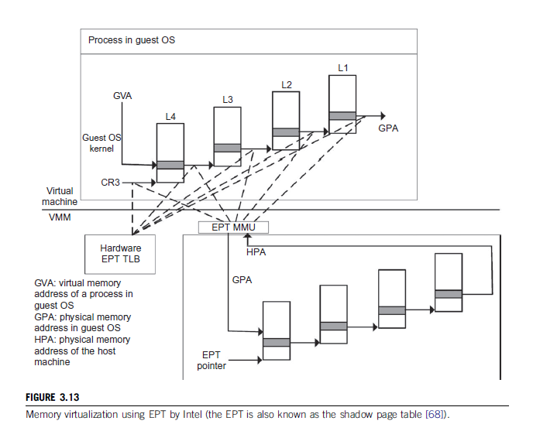
Extended Page Table by Intel for Memory Virtualization

Slide 54
3.3.4 I/O Virtualization
•I/O virtualization involves managing the routing of I/O requests between virtual devices and the shared physical hardware.
•At the time of this writing, there are three ways to implement I/O virtualization: 1) full device emulation, 2) para-virtualization, and 3) direct I/O.
•Full device emulation is the first approach for I/O virtualization. Generally, this approach emulates well-known, real-world devices.
–All the functions of a device or bus infrastructure, such as device enumeration, identification, interrupts, and DMA, are replicated in software.
–This software is located in the VMM and acts as a virtual device. The I/O access requests of the guest OS are trapped in the VMM which interacts with the I/O devices. The full device emulation approach is shown in Figure 3.14.
•A single hardware device can be shared by multiple VMs that run concurrently. However, software emulation runs much slower than the hardware it emulates [10,15].

Slide 55
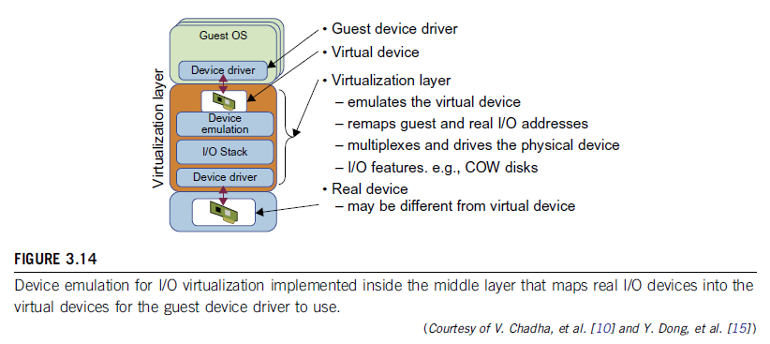
3.3.4 I/O Virtualization

Slide 56
3.3.4 I/O Virtualization
•The para-virtualization method of I/O virtualization is typically used in Xen.
•It is also known as the split driver model consisting of a 1) frontend driver and 2) a backend driver.
•The frontend driver is running in Domain U and the backend driver is running in Domain 0. They interact with each other via a block of shared memory.
•The frontend driver manages the I/O requests of the guest OSes and the backend driver is responsible for managing the real I/O devices and multiplexing the I/O data of different VMs.
•Although para-I/O-virtualization achieves better device performance than full device emulation, it comes with a higher CPU overhead.

Slide 57
3.3.4 I/O Virtualization
•Direct I/O virtualization lets the VM access devices directly. It can achieve close-to-native performance without high CPU costs. However, current direct I/O virtualization implementations focus on networking for mainframes.
•There are a lot of challenges for commodity hardware devices. For example, when a physical device is reclaimed (required by workload migration) for later reassignment, it may have been set to an arbitrary state (e.g., DMA to some arbitrary memory locations) that can function incorrectly or even crash the whole system.
•Since software-based I/O virtualization requires a very high overhead of device emulation, hardware-assisted I/O virtualization is critical.

Slide 58
3.3.4 I/O Virtualization
•Another way to help I/O virtualization is via self-virtualized I/O (SV-IO) [47].
•The key idea of SV-IO is to harness the rich resources of a multicore processor. All tasks associated with virtualizing an I/O device are encapsulated in SV-IO.
•It provides virtual devices and an associated access API to VMs and a management API to the VMM.
•SV-IO defines one virtual interface (VIF) for every kind of virtualized I/O device, such as virtual network interfaces, virtual block devices (disk), virtual camera devices, and others.
•The guest OS interacts with the VIFs via VIF device drivers. Each VIF consists of two message queues. One is for outgoing messages to the devices and the other is for incoming messages from the devices. In addition, each VIF has a unique ID for identifying it in SV-IO.

Slide 59
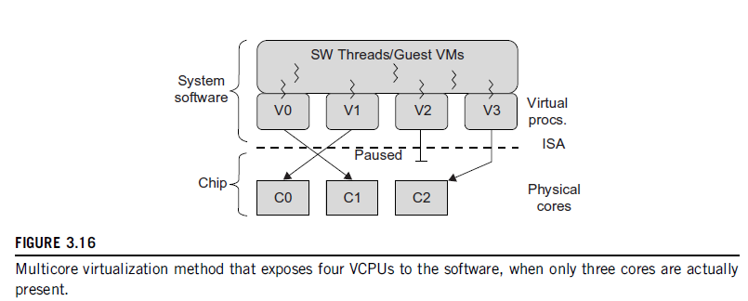
3.3.5 Virtualization in Multicore Processors
Physical cores | Virtual cores
The actual physical cores present in the processor. | There can be more virtual cores visible to a single OS than there are physical cores.
More burden on the software to write applications which can run directly on the cores. | Design of software becomes easier as the hardware assists the software in dynamic resource utilization.
Hardware provides no assistance to the software and is hence simpler. | Hardware provides assistance to the software and is hence more complex.
Poor resource management. | Better resource management.
The lowest level of system software has to be modified. | The lowest level of system software need not be modified.

Slide 60
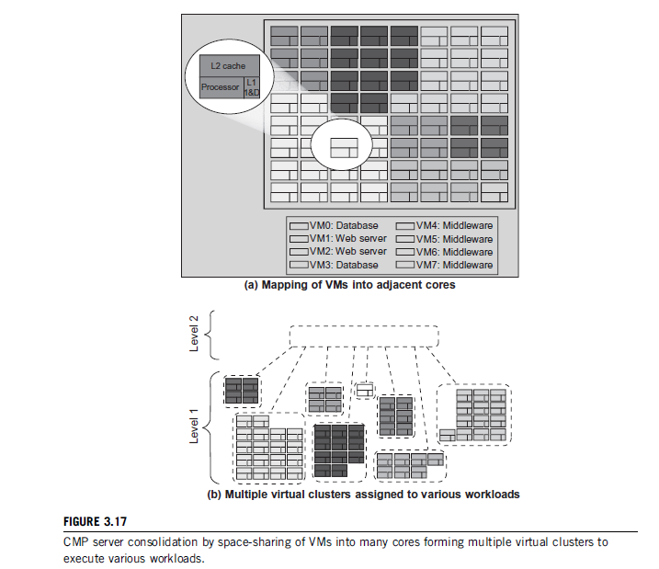
3.3.5 Virtualization in Multicore Processors
Virtual Hierarchy

Slide 61
3.4 VIRTUAL CLUSTERS AND RESOURCE MANAGEMENT
•A physical cluster is a collection of servers (physical machines) interconnected by a physical network such as a LAN.
•In Chapter 2, we studied various clustering techniques on physical machines. Here, we introduce virtual clusters and study its properties as well as explore their potential applications.
•In this section, we will study three critical design issues of virtual clusters: 1) live migration of VMs, 2) memory and file migrations, and 3) dynamic deployment of virtual clusters.
•When a traditional VM is initialized, the administrator needs to manually write configuration information or specify the configuration sources. When more VMs join a network, an inefficient configuration always causes problems with overloading or underutilization.
•Amazon’s Elastic Compute Cloud (EC2) is a good example of a web service that provides elastic computing power in a cloud. EC2 permits customers to create VMs and to manage user accounts over the time of their use.

Slide 62
3.4.1 Physical versus Virtual Clusters
•Virtual clusters are built with VMs installed at distributed servers from one or more physical clusters.
•The VMs in a virtual cluster are interconnected logically by a virtual network across several physical networks.
•Figure 3.18 illustrates the concepts of virtual clusters and physical clusters. Each virtual cluster is formed with physical machines or a VM hosted by multiple physical clusters.

Slide 63
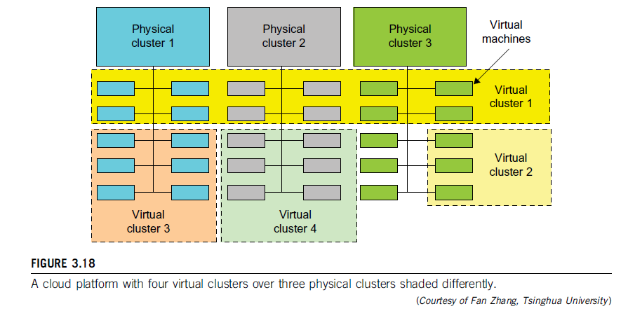
3.4.1 Physical versus Virtual Clusters

Slide 64
3.4.1 Physical versus Virtual Clusters
•The virtual cluster boundaries are shown as distinct boundaries. The provisioning of VMs to a virtual cluster is done dynamically to have the following interesting properties:
–The virtual cluster nodes can be either physical or virtual machines. Multiple VMs running with different OSes can be deployed on the same physical node.
–A VM runs with a guest OS, which is often different from the host OS, that manages the resources in the physical machine, where the VM is implemented.
–The purpose of using VMs is to consolidate multiple functionalities on the same server. This will greatly enhance server utilization and application flexibility.
–VMs can be colonized (replicated) in multiple servers for the purpose of promoting distributed parallelism, fault tolerance, and disaster recovery.
–The size (number of nodes) of a virtual cluster can grow or shrink dynamically, similar to the way an overlay network varies in size in a peer-to-peer (P2P) network.
–The failure of any physical nodes may disable some VMs installed on the failing nodes. But the failure of VMs will not pull down the host system.20

Slide 65
3.4.1 Physical versus Virtual Clusters
•Since system virtualization has been widely used, it is necessary to effectively manage VMs running on a mass of physical computing nodes (also called virtual clusters) and consequently build a high-performance virtualized computing environment.
•This involves virtual cluster deployment, monitoring and management over large-scale clusters, as well as resource scheduling, load balancing, server consolidation, fault tolerance, and other techniques.
•The different node colors in Figure 3.18 refer to different virtual clusters. In a virtual cluster system, it is quite important to store the large number of VM images efficiently.

Slide 66
3.4.1 Physical versus Virtual Clusters
•Figure 3.19 shows the concept of a virtual cluster based on application partitioning or customization.
•The different colors in the figure represent the nodes in different virtual clusters.
•As a large number of VM images might be present, the most important thing is to determine how to store those images in the system efficiently.
•There are common installations for most users or applications, such as operating systems or user-level programming libraries. These software packages can be preinstalled as templates (called template VMs). With these templates, users can build their own software stacks.
•New OS instances can be copied from the template VM. User-specific components such as programming libraries and applications can be installed to those instances.
•Three physical clusters are shown on the left side of Figure 3.18. Four virtual clusters are created on the right, over the physical clusters.
•The physical machines are also called host systems. In contrast, the VMs are guest systems. The host and guest systems may run with different operating systems. Each VM can be installed on a remote server or replicated on multiple servers belonging to the same or different physical clusters.
•The boundary of a virtual cluster can change as VM nodes are added, removed, or migrated dynamically over time.

Slide 67
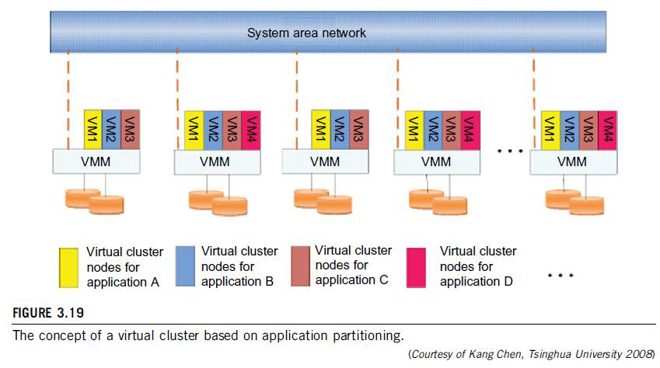
3.4.1 Physical versus Virtual Clusters

Slide 68
3.4.1.1 Fast Deployment and Effective Scheduling
Fast Deployment
•The system should have the capability of fast deployment. Here, deployment means two things:
•1) to construct and distribute software stacks (OS, libraries, applications) to a physical node inside clusters as fast as possible.
•2) to quickly switch runtime environments from one user’s virtual cluster to another user’s virtual cluster. If one user finishes using his system, the corresponding virtual cluster should shut down or suspend quickly to save the resources to run other VMs for other users.

Slide 69
3.4.1.1 Fast Deployment and Effective Scheduling
Effective Scheduling
•The concept of “green computing” has attracted much attention recently. However, previous approaches have focused on saving the energy cost of components in a single workstation without a global vision. Consequently, they do not necessarily reduce the power consumption of the whole cluster.
•The live migration of VMs allows workloads of one node to transfer to another node. However, it does not guarantee that VMs can randomly migrate among themselves. In fact, the potential overhead caused by live migrations of VMs cannot be ignored.
•The overhead may have serious negative effects on cluster utilization, throughput, and QoS issues.
•Therefore, the challenge is to determine how to design migration strategies to implement green computing without influencing the performance of clusters.
•Another advantage of virtualization is load balancing of applications in a virtual cluster. Load balancing can be achieved using the load index and frequency of user logins.
•The automatic scale-up and scale-down mechanism of a virtual cluster can be implemented based on this model. Consequently, we can increase the resource utilization of nodes and shorten the response time of systems.
•Mapping VMs onto the most appropriate physical node should promote performance.
Dynamically adjusting loads among nodes by live migration of VMs is desired, when the loads on cluster nodes become quite unbalanced.

Slide 70
3.4.1.2 High-Performance Virtual Storage
•A template is a disk image that includes a preinstalled operating system with or without certain application software.
•The template VM can be distributed to several physical hosts in the cluster to customize the VMs.
•In addition, existing software packages reduce the time for customization.
•It is important to efficiently manage the disk spaces occupied by template software
packages. Some storage architecture design can be applied to reduce duplicated blocks in a distributed file system of virtual clusters. Hash values are used to compare the contents of data blocks.
•Basically, there are four steps to deploy a group of VMs onto a target cluster: 1) preparing the disk image, 2) configuring the VMs, 3) choosing the destination nodes, and 4) executing the VM deployment command on every host.
•Users choose a proper template according to their requirements and make a duplicate of it as their own disk image.
•Templates could implement the COW (Copy on Write) format. A new COW backup file is very small and easy to create and transfer. Therefore, it definitely reduces disk space consumption.
•In addition, VM deployment time is much shorter than that of copying the whole raw image file.

Slide 71
3.4.1.2 High-Performance Virtual Storage
•Every VM is configured with a name, disk image, network setting, and allocated CPU and memory.
•One needs to record each VM configuration into a file. However, this method is inefficient when managing a large group of VMs.
•VMs with the same configurations could use pre-edited profiles to simplify the process. In this scenario, the system configures the VMs according to the chosen profile.
•A strategy to choose the proper destination host for any VM is needed. The deployment principle is to fulfill the VM requirement and to balance workloads among the whole host network.

Slide 72
3.4.2 Live VM Migration Steps and Performance Effects
•When a VM fails, its role could be replaced by another VM on a different node.
•This is different from physical-to-physical failover in a traditional physical cluster. The advantage is enhanced failover flexibility.
•The potential drawback is that a VM must stop playing its role if its residing host node fails. However, this problem can be mitigated with VM life migration.

Slide 73
3.4.2 Live VM Migration Steps and Performance Effects
•There are four ways to manage a virtual cluster.
•First, you can use a guest-based manager, by which the cluster manager resides on a guest system. In this case, multiple VMs form a virtual cluster.
•For example, openMosix is an open source Linux cluster running different guest systems on top of the Xen hypervisor.
•Another example is Sun’s cluster Oasis, an experimental Solaris cluster of VMs supported by a VMware VMM.
•Second, you can build a cluster manager on the host systems. The host-based manager supervises the guest systems and can restart the guest system on another physical machine.
•A good example is the VMware HA system that can restart a guest system after failure.
•These two cluster management systems are either guest-only or host-only, but they do not mix.
•A third way to manage a virtual cluster is to use an independent cluster manager on both the host and guest systems. This will make infrastructure management more complex.
•Finally, you can use an integrated cluster on the guest and host systems. This means the manager must be designed to distinguish between virtualized resources and physical resources.

Slide 74
3.4.2 Live VM Migration Steps and Performance Effects
Various cluster management schemes can be greatly enhanced when VM life migration is enabled with minimal overhead.
•VMs can be live-migrated from one physical machine to another; in case of failure, one VM can be replaced by another VM.
•The major attraction of this scenario is that virtual clustering provides dynamic resources that can be quickly put together upon user demand or after a node failure.
•When a VM runs a live service, it is necessary to make a trade-off to ensure that the migration occurs in a manner that minimizes all three metrics. The motivation is to design a live VM migration scheme with negligible downtime, the lowest network bandwidth consumption, and a reasonable total migration time.

Slide 75
3.4.2 Live VM Migration Steps and Performance Effects
•A VM can be in one of the following four states:
•An inactive state is defined by the virtualization platform, under which the VM is not enabled.
•An active state refers to a VM that has been instantiated at the virtualization platform to perform a real task.
•A paused state corresponds to a VM that has been instantiated but disabled to process a task or paused in a waiting state.
•A VM enters the suspended state if its machine file and virtual resources are stored back to the disk.

Slide 76
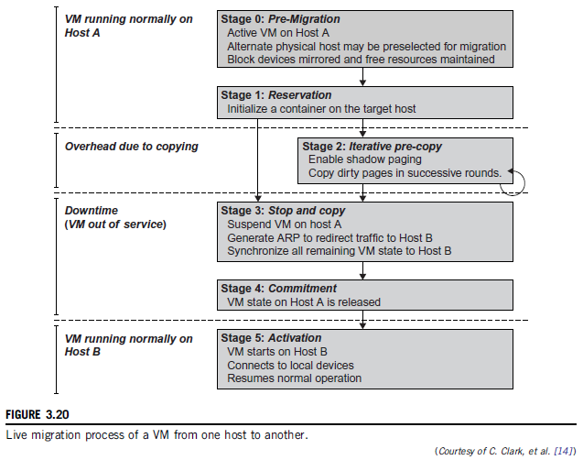
3.4.2 Live VM Migration Steps and Performance Effects

Slide 77
3.4.2 Live VM Migration Steps and Performance Effects
As shown in Figure 3.20, live migration of a VM consists of the following six steps:
•Steps 0 and 1: Start migration. This step makes preparations for the migration, including determining the migrating VM and the destination host. Although users could manually make a VM migrate to an appointed host, in most circumstances, the migration is automatically started by strategies such as load balancing and server consolidation.
•Steps 2: Transfer memory. Since the whole execution state of the VM is stored in memory, sending the VM’s memory to the destination node ensures continuity of the service provided by the VM. All of the memory data is transferred in the first round, and then the migration controller recopies the memory data which is changed in the last round. These steps keep iterating until the dirty portion of the memory is small enough to handle the final copy. Although precopying memory is performed iteratively, the execution of programs is not obviously interrupted.

Slide 78
3.4.2 Live VM Migration Steps and Performance Effects
•Step 3: Suspend the VM and copy the last portion of the data. The migrating VM’s execution is suspended when the last round’s memory data is transferred. Other nonmemory data such as CPU and network states should be sent as well. During this step, the VM is stopped and its applications will no longer run. This “service unavailable” time is called the “downtime” of migration, which should be as short as possible so that it can be negligible to users.
•Steps 4 and 5: Commit and activate the new host. After all the needed data is copied, on the destination host, the VM reloads the states and recovers the execution of programs in it, and the service provided by this VM continues. Then the network connection is redirected to the new VM and the dependency to the source host is cleared. The whole migration process finishes by removing the original VM from the source host.

Slide 79
3.4.2 Live VM Migration Steps and Performance Effects
•Figure 3.21 shows the effect on the data transmission rate (Mbit/second) of live migration of a VM from one host to another. Before copying the VM with 512 KB files for 100 clients, the data throughput was 870 MB/second.
•The first precopy takes 63 seconds, during which the rate is reduced to 765 MB/second. Then the data rate reduces to 694 MB/second in 9.8 seconds for more iterations of the copying process.
•The system experiences only 165 ms of downtime, before the VM is restored at the destination host. This experimental result shows a very small migration overhead in live transfer of a VM between host nodes. This is critical to achieve dynamic cluster reconfiguration and disaster recovery as needed in cloud computing.

Slide 80
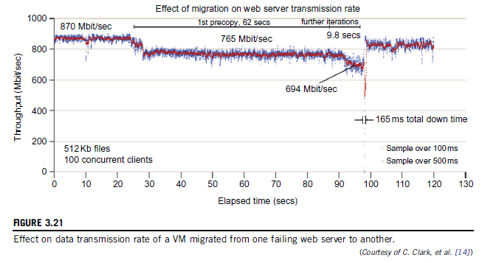
3.4.2 Live VM Migration Steps and Performance Effects

Slide 81
3.4.2 Live VM Migration Steps and Performance Effects Alternative Approaches
•In the pre-copy phase, although a VM service is still available, much performance degradation will occur because the migration daemon continually consumes network bandwidth to transfer dirty pages in each round. Moreover, the maximum number of iterations must be set because not all applications’ dirty pages are ensured to converge to a small writable working set over multiple rounds. In fact, these issues with the pre-copy approach are caused by the large amount of transferred data during the whole migration process.
•A checkpointing/recovery and trace/replay approach (CR/ TR-Motion) is proposed to provide fast VM migration. This approach transfers the execution trace file in iterations rather than dirty pages, which is logged by a trace daemon. Apparently, the total size of all log files is much less than that of dirty pages. The total migration time and downtime of migration are drastically reduced. However, CR/TR-Motion is valid only when the log replay rate is larger than the log growth rate.

Slide 82
3.4.2 Live VM Migration Steps and Performance Effects Alternative Approaches
•Another strategy of post-copy is introduced for live migration of VMs. Here, all memory pages are transferred only once during the whole migration process and the baseline total migration time is reduced. But the downtime is much higher than that of pre-copy due to the latency of fetching pages from the source node before the VM can be resumed on the target. With the advent of multicore or many-core machines, abundant CPU resources are available. Even if several VMs reside on a same multicore machine, CPU resources are still rich because physical CPUs are frequently amenable to multiplexing.
•We can exploit these copious CPU resources to compress page frames and the amount of transferred data can be significantly reduced. Memory compression algorithms typically have little memory overhead. Decompression is simple and very fast and requires no memory for decompression.

Slide 83
3.4.3 Migration of Memory, Files, and Network Resources
3.4.3.1 Memory Migration:
•Memory migration is one of the most important aspects of VM migration. Moving the memory instance of a VM from one physical host to another can be approached in any number of ways.
•Memory migration can be in a range of hundreds of megabytes to a few gigabytes in a typical system today, and it needs to be done in an efficient manner.
•The Internet Suspend-Resume (ISR) technique deals with situations where the migration of live machines is not a necessity (Cold Migration).
•Predictably, the downtime (the period during which the service is unavailable due to there being no currently executing instance of a VM) is high.

Slide 84
3.4.3.1 Memory Migration:
•The ISR technique exploits temporal locality as memory states are likely to have considerable overlap in the suspended and the resumed instances of a VM.
•Temporal locality refers to the fact that the memory states differ only by the amount of work done since a VM was last suspended before being initiated for migration.
•To exploit temporal locality, each file in the file system is represented as a tree of small sub-files. A copy of this tree exists in both the suspended and resumed VM instances.
•The advantage of using a tree-based representation of files is that the caching ensures the transmission of only those files which have been changed.

Slide 85
3.4.3.2 File System Migration
•To support VM migration, a system must provide each VM with a consistent, location-independent view of the file system that is available on all hosts.
•1) each VM with its own virtual disk which the file system is mapped to and transport the contents of this virtual disk along with the other states of the VM.
•VMM only accesses its local file system. The relevant VM files are explicitly copied into the local file system for a resume operation and taken out of the local file system for a suspend operation.
•VMM has to store the contents of each VM’s virtual disks in its local files, which have to be moved around with the other state information of that VM.
•2) Another way is to have a global file system (Distributed file system) across all machines where a VM could be located. This way removes the need to copy files from one machine to another because all files are network accessible. A distributed file system is used in ISR serving as a transport mechanism for propagating a suspended VM state.

Slide 86
3.4.3.2 File System Migration
•In smart copying, the VMM exploits spatial locality.
•Typically, people often move between the same small number of locations, such as their home and office. In these conditions, it is possible to transmit only the difference between the two file systems at suspending and resuming locations.
•This technique significantly reduces the amount of actual physical data that has to be moved. In situations where there is no locality to exploit, a different approach is to synthesize much of the state at the resuming site.
•On many systems, user files only form a small fraction of the actual data on disk. Operating system and application software use the majority of storage space.

Slide 87
3.4.3.3 Network Migration
•A migrating VM should maintain all open network connections without relying on forwarding mechanisms on the original host or on support from mobility or redirection mechanisms.
•To enable remote systems to locate and communicate with a VM, each VM must be assigned a virtual IP address known to other entities. This address can be distinct from the IP address of the host machine where the VM is currently located.
•Each VM can also have its own distinct virtual MAC address. The VMM maintains a mapping of the virtual IP and MAC addresses to their corresponding VMs.
•If the source and destination machines of a VM migration are typically connected to a single switched LAN, an ARP reply from the migrating host is provided advertising that the IP has moved to a new location. This solves the open network connection problem by reconfiguring all the peers to send future packets to a new location. Although a few packets that have already been transmitted might be lost, there are no other problems with this mechanism.
•Alternatively, on a switched network, the migrating OS can keep its original Ethernet MAC address and rely on the network switch to detect its move to a new port.

Slide 88
3.4.3.4 Live Migration of VM Using Xen
• Xen supports live migration.
It is a useful feature and natural extension to virtualization platforms that
allows for the transfer of a VM from one physical machine to another with little or no downtime of the services hosted by the VM.
Live migration transfers the working state and memory of a VM across a network when it is running.
Xen also supports VM migration by using a mechanism called Remote Direct Memory Access (RDMA).

Slide 89
3.4.3.4 Live Migration of VM Using Xen
RDMA speeds up VM migration by avoiding TCP/IP stack processing overhead.
RDMA implements a different transfer protocol whose origin and destination VM buffers must be registered before any transfer operations occur, reducing it to a “one-sided” interface.
Data communication over RDMA does not need to involve the CPU, caches, or context switches. This allows migration to be carried out with minimal impact on guest operating systems and hosted applications.
Figure 3.22 shows the a compression scheme for VM migration.

Slide 90
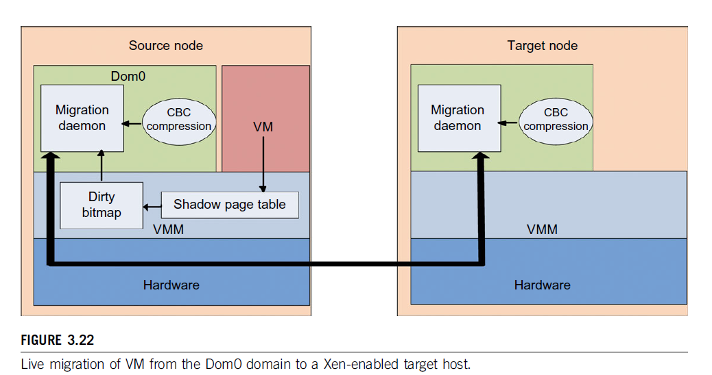
3.4.3.4 Live Migration of VM Using Xen

Slide 91
3.4.3.4 Live Migration of VM Using Xen
Migration daemons running in the management VMs are responsible for performing migration.
Shadow page tables in the VMM layer trace modifications to the memory page in migrated VMs during the precopy phase. Corresponding flags are set in a dirty bitmap.
At the start of each precopy round, the bitmap is sent to the migration daemon. Then, the bitmap is cleared and the shadow page tables are destroyed and re-created in the next round.
The system resides in Xen’s management VM. Memory pages denoted by bitmap are extracted and compressed before they are sent to the destination.
The compressed data is then decompressed on the target.

Slide 92
3.4.3.4 Live Migration of VM Using Xen
Migration daemons running in the management VMs are responsible for performing migration.
Shadow page tables in the VMM layer trace modifications to the memory page in migrated VMs during the precopy phase. Corresponding flags are set in a dirty bitmap.
At the start of each precopy round, the bitmap is sent to the migration daemon. Then, the bitmap is cleared and the shadow page tables are destroyed and re-created in the next round.
The system resides in Xen’s management VM. Memory pages denoted by bitmap are extracted and compressed before they are sent to the destination.
The compressed data is then decompressed on the target.

Slide 93
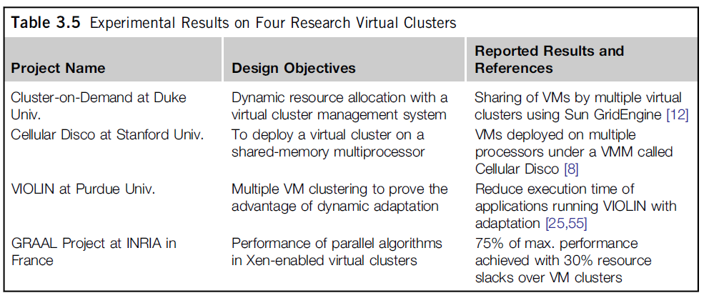
3.4.4 Dynamic Deployment of Virtual Clusters
Table 3.5 summarizes four virtual cluster research projects. We briefly introduce them here just to identify their design objectives and reported results.
The Cellular Disco at Stanford is a virtual cluster built in a shared-memory multiprocessor system.
The INRIA virtual cluster was built to test parallel algorithm performance.

Slide 94
3.4.4 Dynamic Deployment of Virtual Clusters
The Cluster-on-Demand (COD) Project at Duke University Developed by researchers at Duke University, the COD (Cluster-on-Demand) project is a virtual cluster management system for dynamic allocation of servers from a computing pool to multiple virtual clusters.
The idea is illustrated by the prototype implementation of the COD shown in Figure 3.23. The COD partitions a physical cluster into multiple virtual clusters (vClusters). vCluster owners specify the operating systems and software for their clusters through an XML-RPC interface.
The vClusters run a batch schedule from Sun’s GridEngine on a web server cluster. The COD system can respond to load changes in restructuring the virtual clusters dynamically

Slide 95
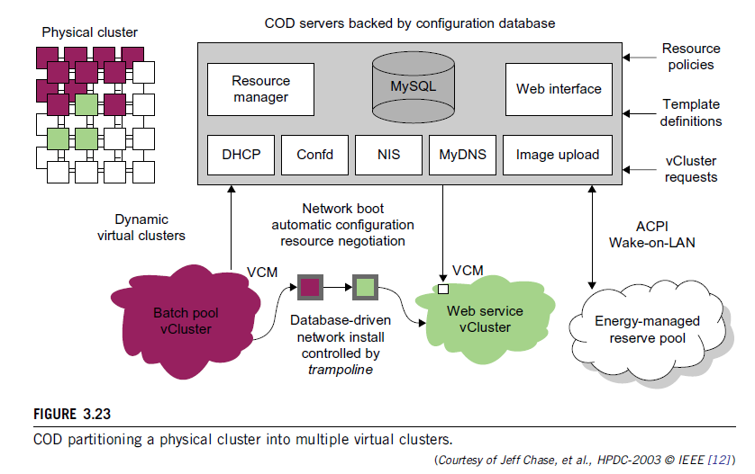
3.4.4 Dynamic Deployment of Virtual Clusters

Slide 96
3.4.4 Dynamic Deployment of Virtual Clusters
The Duke researchers used the Sun GridEngine scheduler to demonstrate that dynamic virtual clusters are an enabling abstraction for advanced resource management in computing utilities such as grids.
The system supports dynamic, policy-based cluster sharing between local users and hosted grid services.
Attractive features include resource reservation, adaptive provisioning, scavenging of idle resources, and dynamic instantiation of grid services. The COD servers are backed by a configuration database.
This system provides resource policies and template definition in response to user requests.

Slide 97
3.5 VIRTUALIZATION FOR DATA-CENTER AUTOMATION
Data centers have grown rapidly in recent years, and all major IT companies are pouring their resources into building new data centers
Data-center automation means that huge volumes of hardware,
software, and database resources in these data centers can be allocated dynamically to millions of Internet users simultaneously, with guaranteed QoS and cost-effectiveness.
This automation process is triggered by the growth of virtualization products and cloud computing services.
Virtualization is moving towards enhancing mobility, reducing planned downtime (for maintenance), and increasing the number of virtual clients.
The latest virtualization development highlights high availability (HA), backup services, workload balancing, and further increases in client bases.
We will discuss server consolidation, virtual storage, OS support, and trust management in automated data-center designs.

Slide 98
3.5.1 Server Consolidation in Data Centers
In data centers, a large number of heterogeneous workloads can run on servers at various times. These heterogeneous workloads can be roughly divided into two categories: chatty workloads and noninteractive workloads
Chatty workloads may burst at some point and return to a silent state at some other point. A web video service is an example of this, whereby a lot of people use it at night and few people use it during the day
Noninteractive workloads do not require people’s efforts to make progress after they are submitted. High-performance computing is a typical example of this.
At various stages, the requirements for resources of these workloads are dramatically different. However, to guarantee that a workload will always be able to cope with all demand levels, the workload is statically allocated enough resources so that peak demand is satisfied.

Slide 99
3.5.1 Server Consolidation in Data Centers
Therefore, it is common that most servers in data centers are underutilized. A large amount of hardware, space, power, and management cost of these servers is wasted.
Server consolidation is an approach to improve the low utility ratio of hardware resources by reducing the number of physical servers.
Among several server consolidation techniques such as centralized and physical consolidation, virtualization-based server consolidation is the most powerful.
Data centers need to optimize their resource management. Yet these techniques are performed with the granularity of a full server machine, which makes resource management far from well optimized. Server virtualization enables smaller resource allocation than a physical machine.

Slide 100
3.5.1 Server Consolidation in Data Centers
In general, the use of VMs increases resource management complexity.
Server virtualization has the following side effects:
Consolidation enhances hardware utilization. Many underutilized servers are consolidated into fewer servers to enhance resource utilization. Consolidation also facilitates backup services and disaster recovery.
This approach enables more agile provisioning and deployment of resources. In a virtual environment, the images of the guest OSes and their applications are readily cloned and reused.
The total cost of ownership is reduced. In this sense, server virtualization causes deferred purchases of new servers, a smaller data-center footprint, lower maintenance costs, and lower power, cooling, and cabling requirements.
This approach improves availability and business continuity. The crash of a guest OS has no effect on the host OS or any other guest OS. It becomes easier to transfer a VM from one server to another, because virtual servers are unaware of the underlying hardware.

Slide 101
3.5.1 Server Consolidation in Data Centers
To automate data-center operations, one must consider resource scheduling, architectural support, power management, automatic or autonomic resource management, performance of analytical models, and so on.
In virtualized data centers, an efficient, on-demand, fine-grained scheduler is one of the key factors to improve resource utilization. Scheduling and reallocations can be done in a wide range of levels in a set of data centers.
The levels match at least at the VM level, server level, and data-center level. Ideally, scheduling and resource reallocations should be done at all levels.

Slide 102
3.5.2 Virtual Storage Management
Generally, the data stored in this environment can be classified into two categories:
VM images and application data.
The VM images are special to the virtual environment, while application data includes all other data which is the same as the data in traditional OS environments.

